Slide 1
Machine Learning Basics
(HPRC)
Narendra Chaudhary

Slide 2
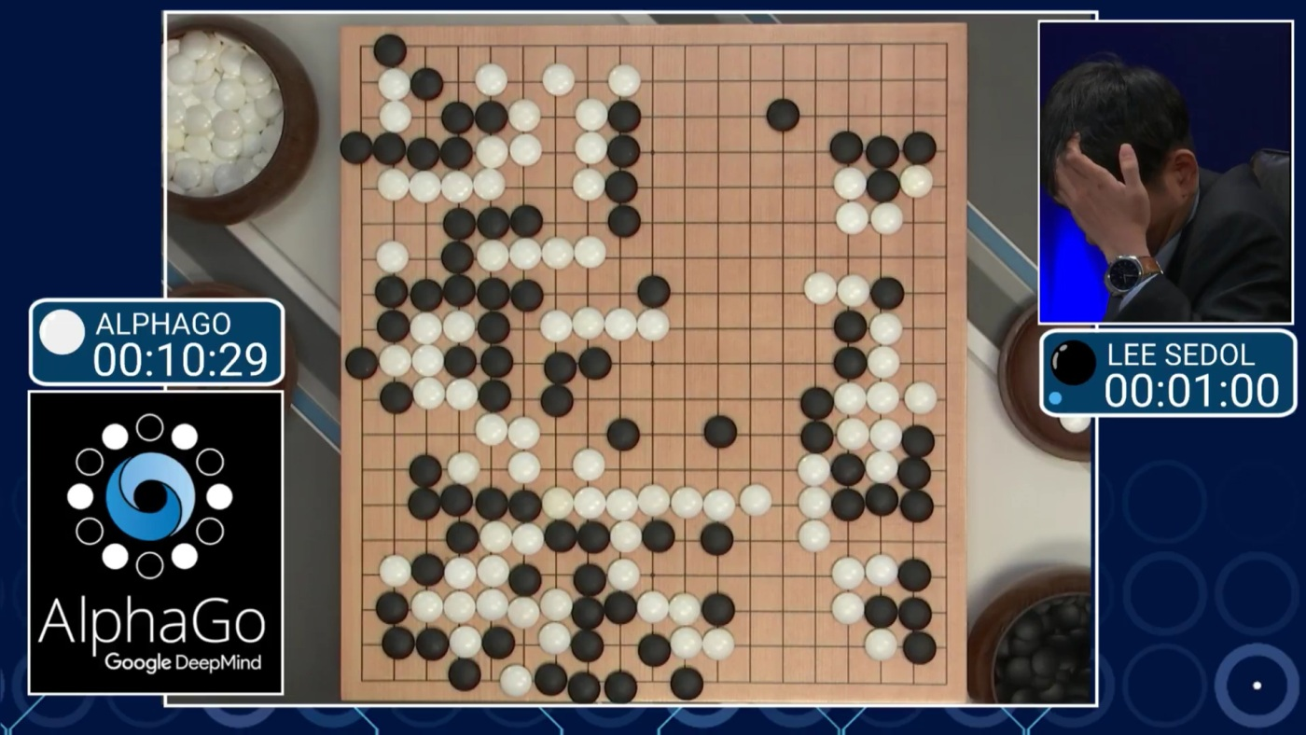
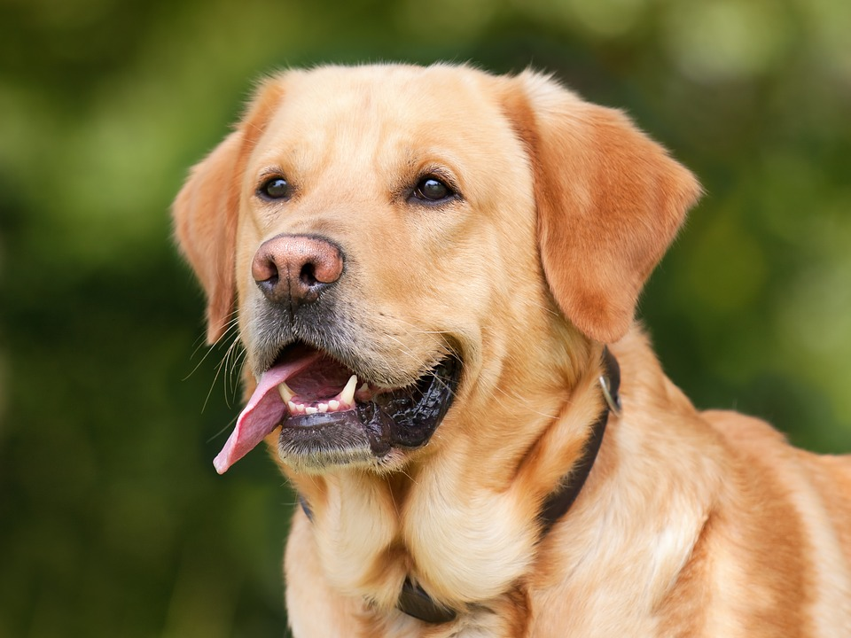
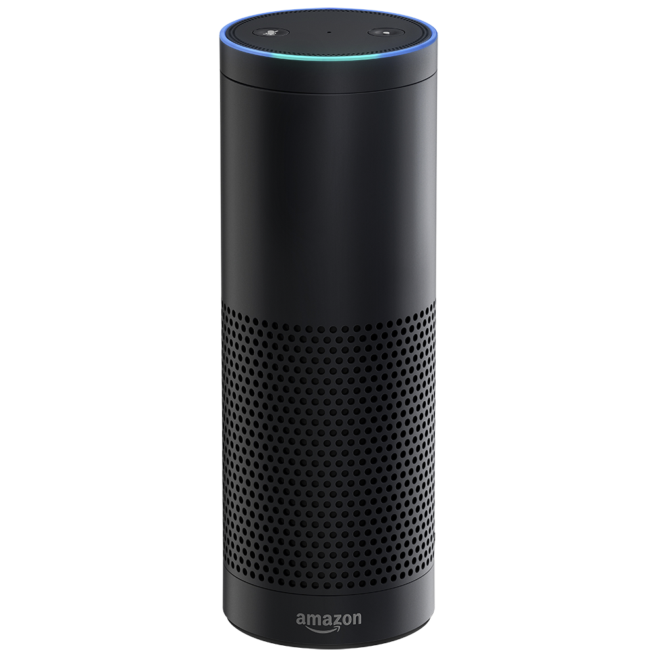
Machine Learning
Recognizing objects in images. What is a dog ?
Understanding language(Alexa, Siri, Cortana)
Self driving cars
Playing games (Chess, AlphaGo)
Other applications where we have lot of data.
Giant robots taking over the world ???

Slide 3
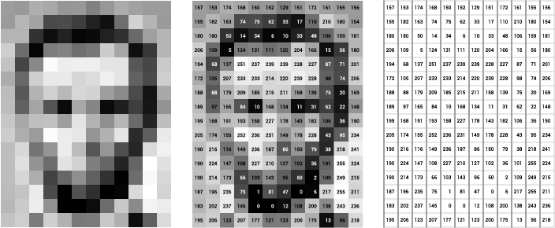
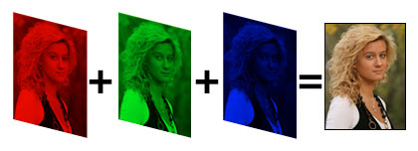
Image (to computer)
What is an image to a computer ?
Answer - Bunch of numbers just like everything else.
Grayscale image - Sheet of numbers (2D array) ranging from 0 to 255.
Lower number - dark area
Higher number - bright area
Color image - 3 different sheets of numbers (Red, Green and Blue). 3D array
Image Dimension = (Height, Width, channels)

Slide 4
Image (numbers)

Slide 5
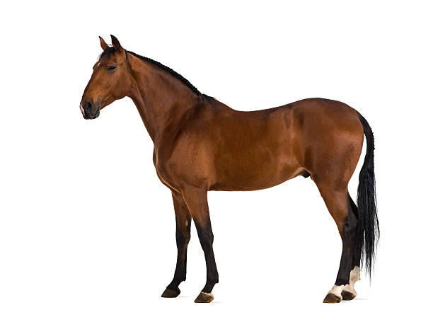
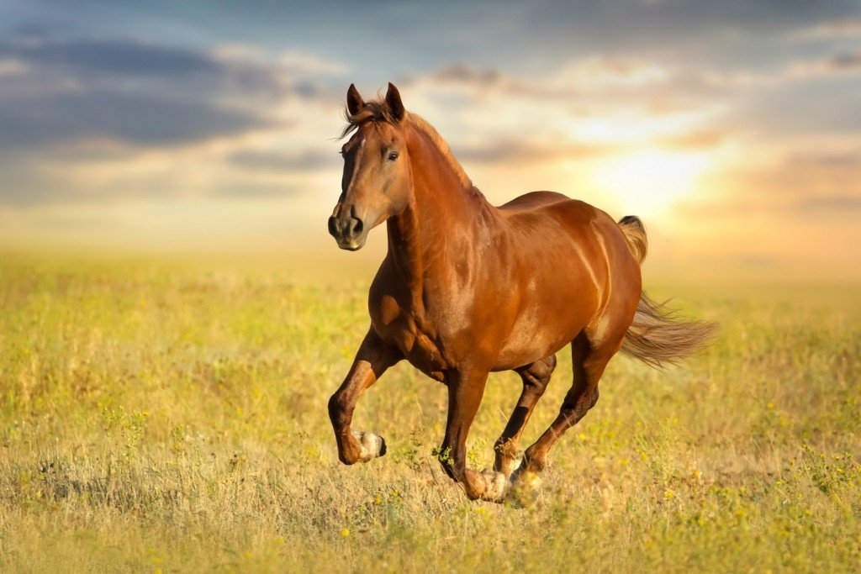
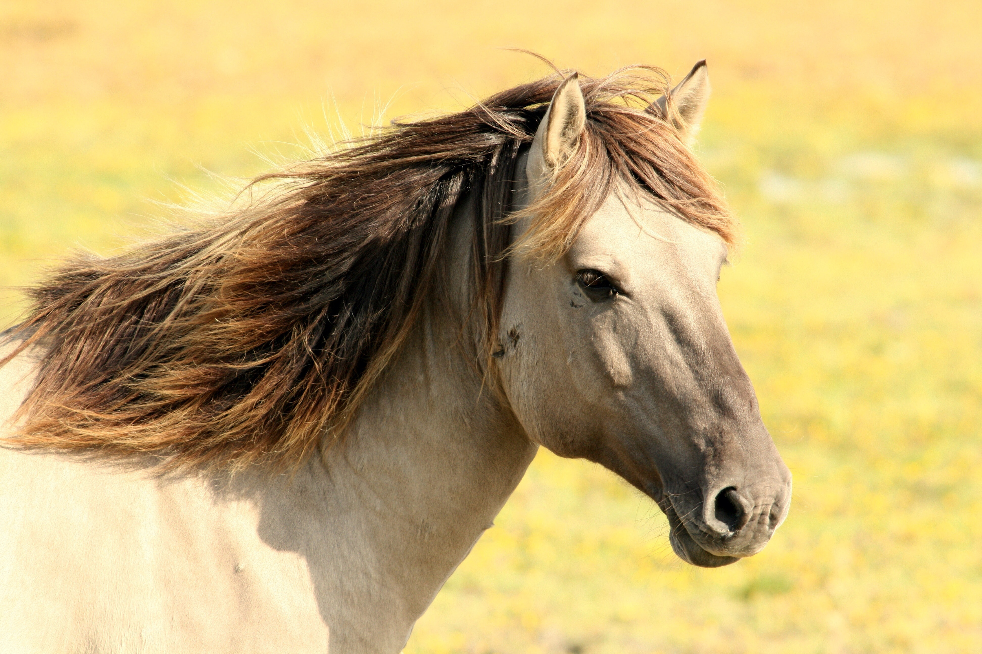
Why Machine learning ?
What is a horse ? Can you define it ?
4 legs
A tail
Very hard to write a program which can recognize objects in images. Like a horse, a car or a flower.
Bunch of numbers == horse ???
Humans and animals know instantly what a horse is
Even though they can’t define it

Slide 6
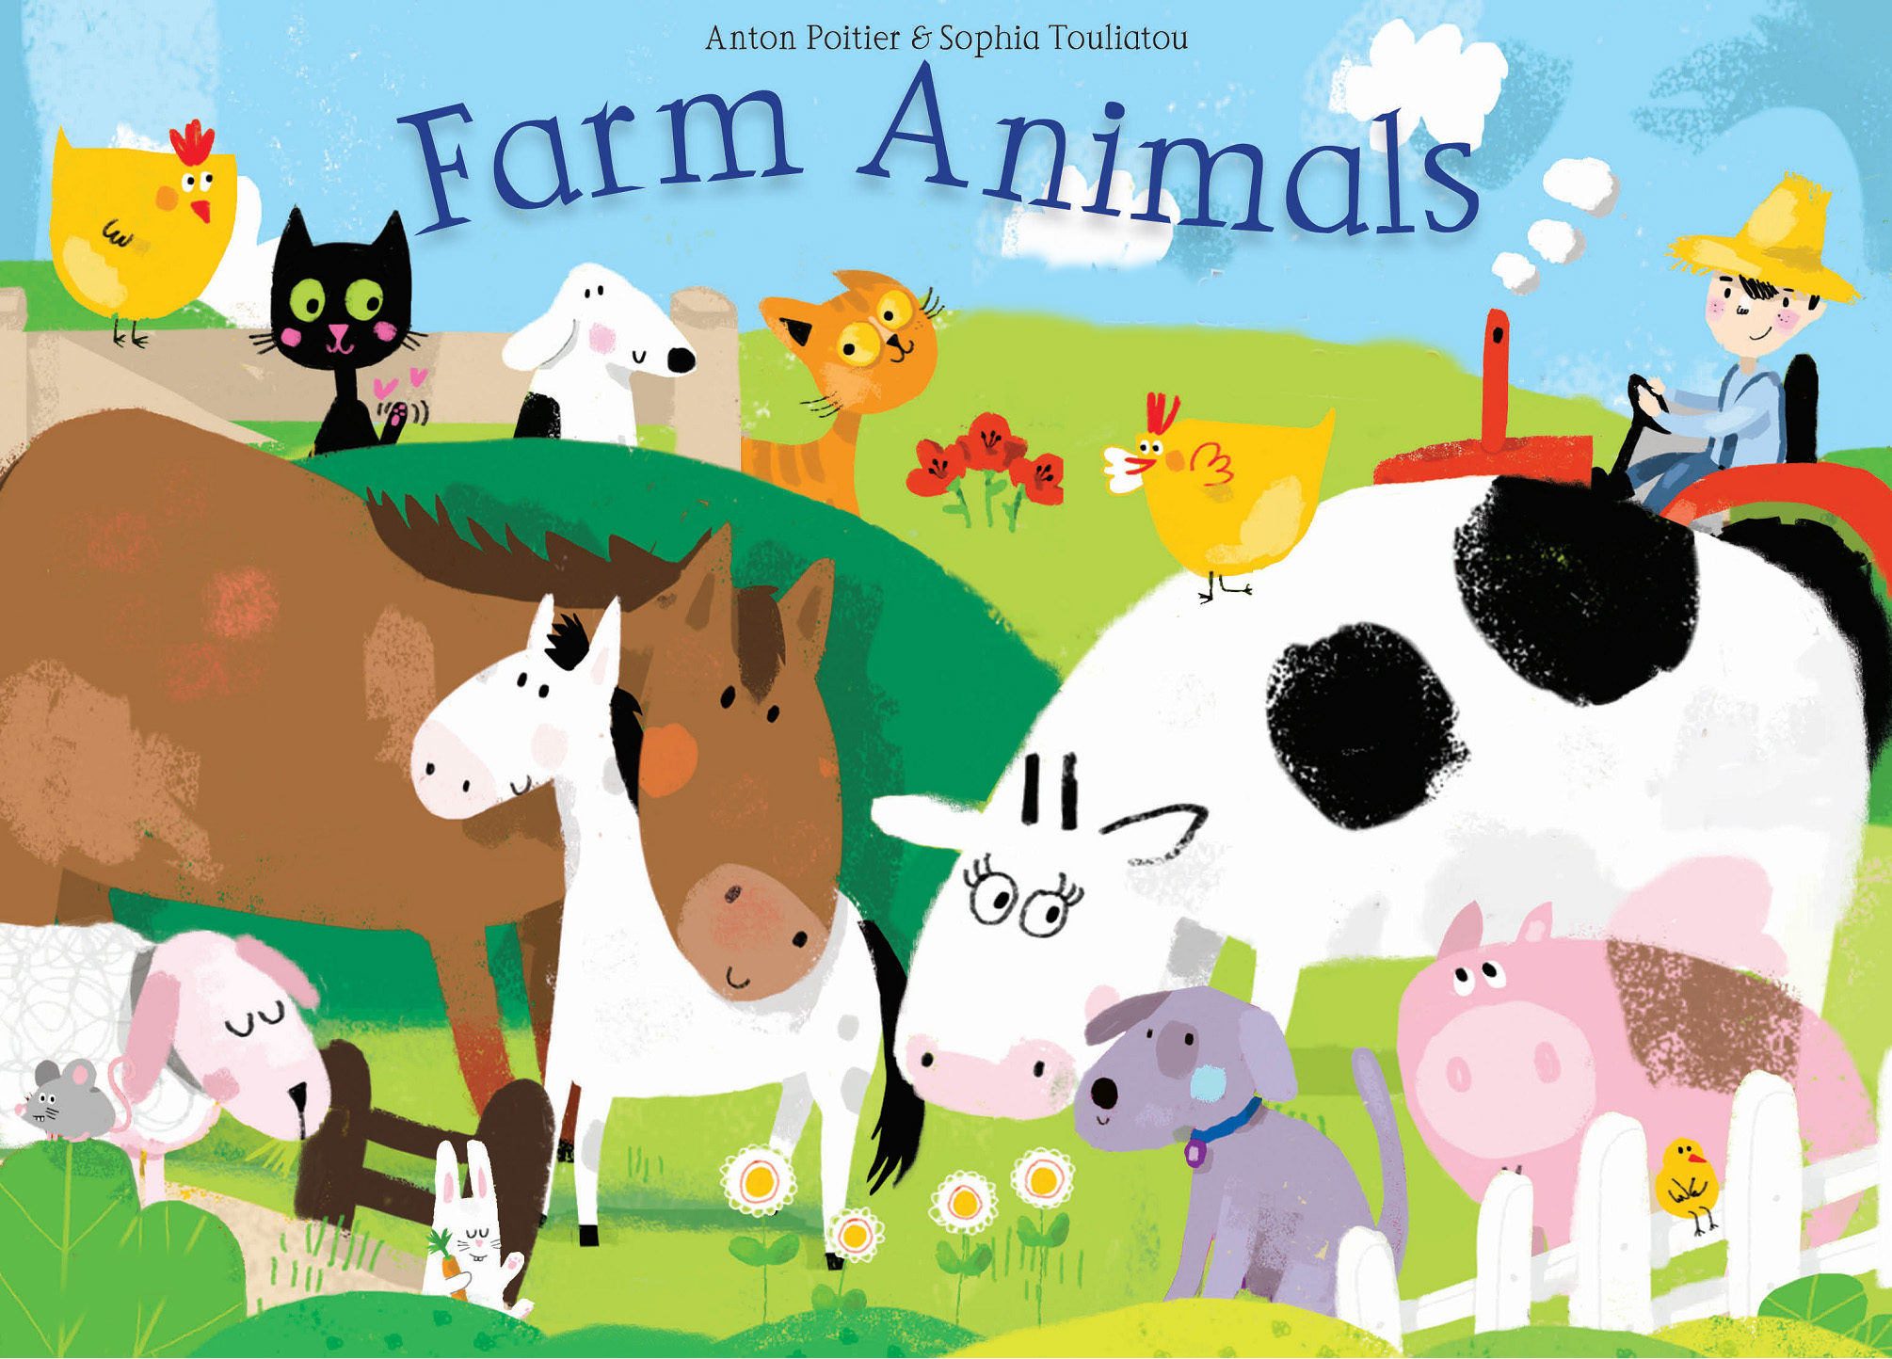
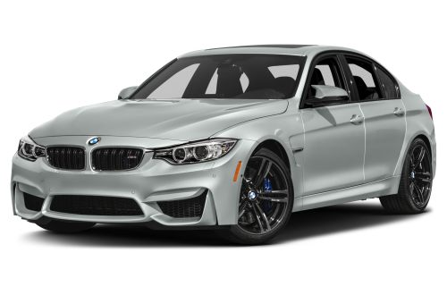
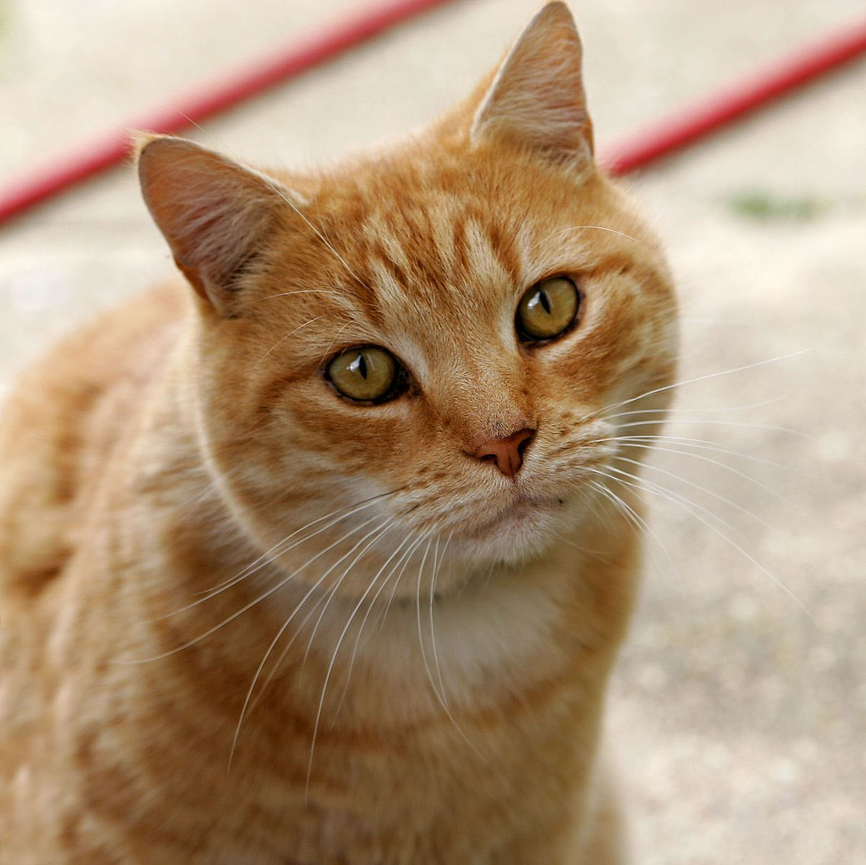
Learning
We know horse, cat, lion because we learned it.
From teachers and parents telling us what a horse is
Children’s book
Learning by various images and their labels
Supervised learning
Car
Cat
Horse

Slide 7



Supervised Machine Learning
Supervised machine learning works the same way as learning from children’s book
What do I need to do supervised machine learning on computers ?
A Machine brain - Model
Training data - Images and their labels (Children’s book)
Methods (functions) in python to train
Libraries like keras, tensorflow, scikit-learn

Slide 8
Alternative Installation
Download bash file. https://github.com/narendrachaudhary51/Teach_machine_learning/blob/master/installation.sh
Open terminal
Cd to Teach_machine_learning
Run ./installation.sh command
Press Y if a question is asked.

Slide 9
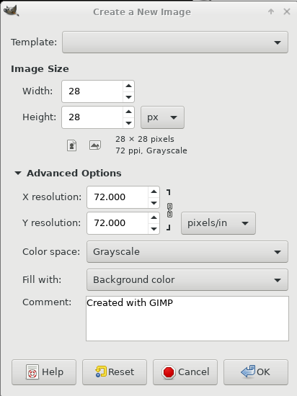
Activity 1 - Create a character image by gimp
Open terminal and write “sudo apt-get install gimp”
Create a folder rename it to “Teach_machine_learning”.
CD to the folder and write command “gimp” in the terminal.
Go to file->New
In the window, write Width = 28 and Height = 28
In Advanced options pick colorspace as “Grayscale”
Zoom in, make black background color and write a number(0-9) with white brush at the center of image.
Export as PNG image and save it in the folder.
We will try to recognize this number using machine learning.

Slide 10
Activity 2 - Training a simple model
In this activity, we will learn following things
All reference code. You can clone it using git clone command.
https://github.com/narendrachaudhary51/Teach_machine_learning
Import important libraries
How to load handwritten number dataset MNIST?
Check dataset and learn about train and test dataset. Reshape data.
Train a simple model (machine brain) on this dataset
Check how good the trained model is ?
How much time it takes ?
How to predict the label of images ?
Can it recognize image with number created in Activity 1.

Slide 11
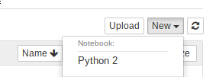
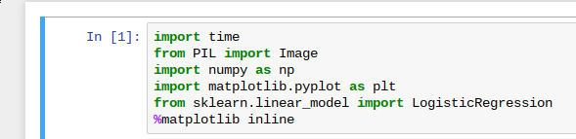
Activity 2 - Training a simple model
In terminal, write this command. “jupyter notebook --no-browser”
Copy the generated url in the web browser
Start a new python2 notebook. From top right.
In first cell import the following
Try to run code in jupyter
Notes:
Add step for running the notebook after copying the commands

Slide 12
Important libraries
Python Imaging library
You can import a function or module using “from” instead of entire library
Numpy library
Used for multidimensional array.
Import as “np”
Array operation functions
Python only had lists earlier
matplotlib.pyplot library
Used for making plots
Showing images
Import as “plt”
scikit-learn library
Machine learning library
We only import LogisticRegression model from linear models

Slide 13
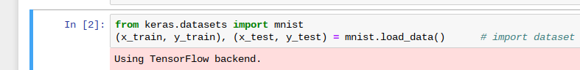
Activity 2 - Training a simple model
Import the handwritten numbers training dataset (MNIST) from keras library.
The data is split into training set and test set.
X arrays contains images while Y arrays contain labels (numpy arrays)
x_train, y_train like exercise in the book
x_test, y_test like exam. Model should not know what will come in the exam.

Slide 14
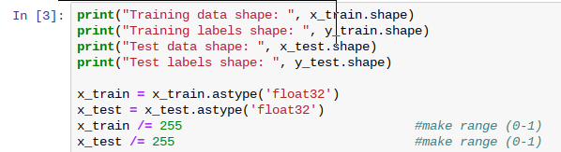
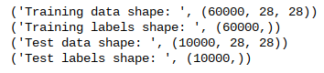
Activity 2 - Training a simple model
Check the shape of data
Change its type
Normalize - Image number in range (0,1).
data shape - 60000 = number of images
Image width = 28
Image height = 28
10000 test images and labels

Slide 15
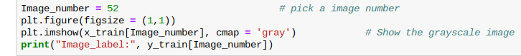
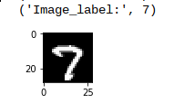
Activity 2 - Training a simple model
Let’s check one of the training image out of the 60000
Image is of number 7 and it has the label number 7.
We are good to proceed

Slide 16
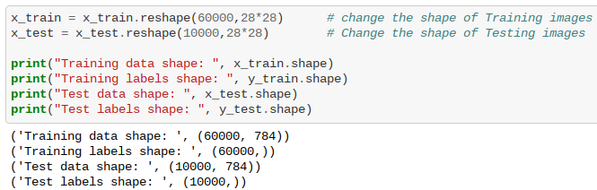
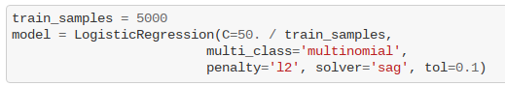
Activity 2 - Training a simple model
Reshape the data
Data reshaped to two dimensions
Create a model (your little machine brain)

Slide 17
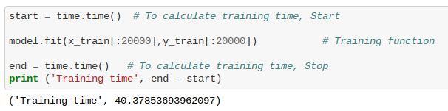
Activity 2 - Training a simple model
Train using model.fit function
fit function requires training images and labels as inputs
Train on subset of training image. For example - we train on 20000 images in the following code. Also try on 100, 500, 1000, 10000.
Check the training time by time.time() function

Slide 18
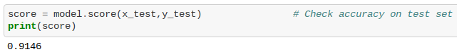
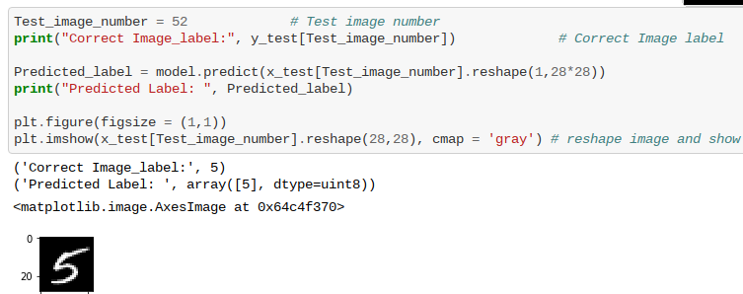
Activity 2 - Training a simple model
After training, check your score(accuracy) on test set.
Use model.predict function to predict label of one of the test image.
You will reshape the data again.

Slide 19
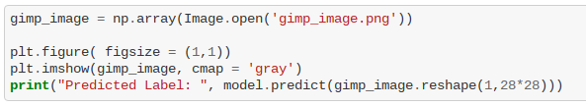
Activity 2 - Training a simple model
Now your model (Machine brain) can find the number in an image.
Import the gimp image you created into code
Use model.predict function to predict the label of the image.
Does it work ?

